Slide 1


CS-482: Introduction to Blockchain and CryptoCurrency
Lecture # 9: Alternative Mining Puzzles

Slide 2
Puzzles are the core of Bitcoin
Incentive system steers participants
Basic features of Bitcoin’s puzzle (recap)
The puzzle is difficult to solve, so attacks are costly
… but not too hard, so honest miners are compensated
What other features could a puzzle have?
Notes:
Recap to earlier lectures?

Slide 3
This lecture
Alternative puzzle designs
Used in practice, and speculative
Variety of possible goals
ASIC resistance, pool resistance, intrinsic benefits...
Essential security requirements

Slide 4
Essential Puzzle Requirements

Slide 5
Puzzle requirements
- Cheap to Verify
- Adjustable difficulty
…
- Chance of winning is proportional to hashpower
- Large players get only proportional advantage
- Even small players get proportional compensation

Slide 6

Bad puzzle: a sequential puzzle
Consider a puzzle that takes N steps to solve
a “Sequential” Proof of Work
N
Solution Found!

Slide 7

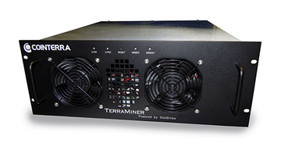
Bad puzzle: a sequential puzzle
Problem: fastest miner always wins the race!
Solution Found!
Notes:
Clipart: from tango project, public domain

Slide 8

Good puzzle → Weighted sample
This property is sometimes called “progress-free”
Notes:
Dart image from wikipedia

Slide 9
ASIC Resistant Puzzles

Slide 10
ASIC resistance - Why? (1 of 2)
Goal: Ordinary people with idle laptops, PCs, or even mobile phones can mine!
Lower barrier to entry
Approach: reduce the gap between custom hardware and general purpose equipment

Slide 11
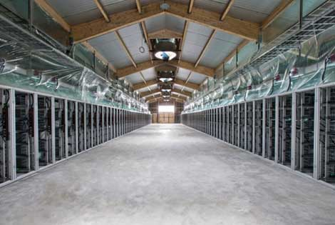
ASIC resistance - Why? (2 of 2)
Goal: Prevent large manufacturers from dominating the game
“Burn-in” advantage
In-house designs
Approach: reduce the “gap” between future hardware and the custom ASICs we already have
Notes:
Image taken from lecture 5

Slide 12
Memory hard puzzles
Premise: the cost and performance of memory is more stable than for processors
10000
Processors
1000
“performance gap”
Memory
Performance
100
Storage
10
‘80 ‘90 ‘00 ‘10 ‘14
Time

Slide 13
scrypt
Colin Percival, 2009
Memory hard hash function
Constant time/memory tradeoff
Most widely used alternative Bitcoin puzzle
Also used elsewhere in security (PW-hashing)
1. Fill memory with random values
2. Read from the memory in random order
Notes:
[5, 4, 1, 1, 0, 0],
[3, 4, 0, 2, 1, 1],
[3, 3, 1, 1, 1, 4],
[0, 2, 3, 4, 4, 5],
[4, 2, 2, 5, 4, 2],
[3, 4, 4, 3, 5, 3]])

Slide 14
scrypt - step 1 of 2 (write)
Input: X
V₁ = H(X)
V₂ = H(V₁) = H(H(X))
V₃ = H(V₂) = H³(X)
…
V_{N} = H^{N}(x)
V₁ | V₂ | V₃ | ... | ... | ...
... | ... | ... | ... | ... | ...
... | ... | …. | ... | ... | ...
... | ... | ... | … | ... | ...
... | ... | ... | ... | ... | ...
... | ... | ... | ... | ... | V_{N}
V₁
V₁ | V₂
V₁ | V₂ | V₃
Notes:
In cryptography, scrypt (pronounced "ess crypt"^{[1]}) is a password-based key derivation function created by Colin Percival, originally for the Tarsnap online backup service.^{[2]} The algorithm was specifically designed to make it costly to perform large-scale custom hardware attacks by requiring large amounts of memory.

Slide 15
scrypt - step 2 of 2 (read)
V₁ | V₂ | V₃ | ... | ... | ...
... | ... | ... | ... | ... | ...
... | ... | …. | ... | ... | ...
... | ... | ... | … | ... | ...
... | ... | ... | ... | ... | ...
... | ... | ... | ... | ... | V_{N}
Input: X
A := H^{N+1}(X)
For N iterations:
i := A mod N
A := H(A xor V_{i})
Output: A

Slide 16
scrypt - time/memory tradeoff
Why is this memory-hard?
Reduce memory by half, 1.5x the # steps
V₁ |  | V₃ |  | V₅
... |  | ... |  | ...
... |  | …. |  | ...
... |  | V_{i-1} | V_{i} | ...
... |  | ... |  | ...
... |  | ... |  | ...
Need to access V_{i} where i is even?
Access V_{i-1}
Compute V_{i} = H(V_{i-1})

Slide 17
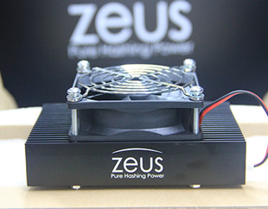
scrypt
Disadvantages:
Also requires N steps, N memory to check
Is it actually ASIC resistant?
scrypt ASICs are already available
Future: PW-hashing research
http://zeusminer.com/
Notes:
Fair use because its cited by source?

Slide 18
Cuckoo hash cycles
John Tromp, 2014
Memory hard puzzle that’s cheap to verify
Input: X
For i = 1 to E:
a := H₀(X + i)
b := N + H₁(X + i)
edge(a mod N, b mod N)
Is there a cycle of size K? If so, Output: X, K edges
N
Notes:
X is random string and see it is possibly a puzzle solution
Finding cycles in graphs requires memory.

Slide 19
Even more approaches
More complicated hash functions
X11: 11 different hash functions combined
Moving target
Change the puzzle periodically
Notes:
Change puzzle and hardware optimized for that would be no more optimal

Slide 20
Counter argument: SHA2 is fine
Bitcoin Mining ASICs aren’t changing much
Big ASICs only marginally more performant than small ones
Affordable ASIC
Expensive ASIC
SHA2
SHA2
SHA2
SHA2
SHA2
Ordinary SHA2 Circuit
SHA2
SHA2
SHA2
SHA2
SHA2
SHA2
SHA2
SHA2
SHA2
SHA2
SHA2
SHA2
SHA2
SHA2
...
...

Slide 21
Proof-of-useful-work

Slide 22

Primecoin
Sunny King, 2013
Puzzle based on finding large prime numbers
Cunningham chain:
p₁, p₂, … p_{n} where p_{i} = 2^{i} a + 1
Each p_{i} is a large (probable) prime
p₁ is divisible by H(prev || mrkl_root || nonce)

Slide 23
Primecoin
Many of the largest known Cunningham chains have come from Primecoin miners
Hard problem? Studied by others (e.g., PrimeGrid)
Usefulness? Maybe - at least one known use

Slide 24
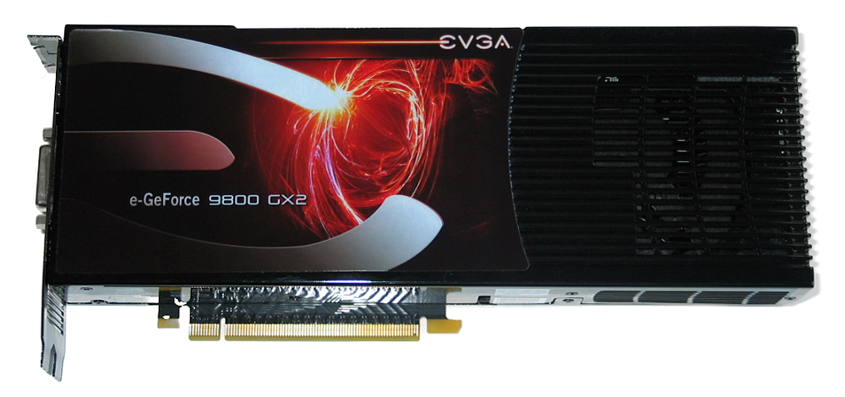
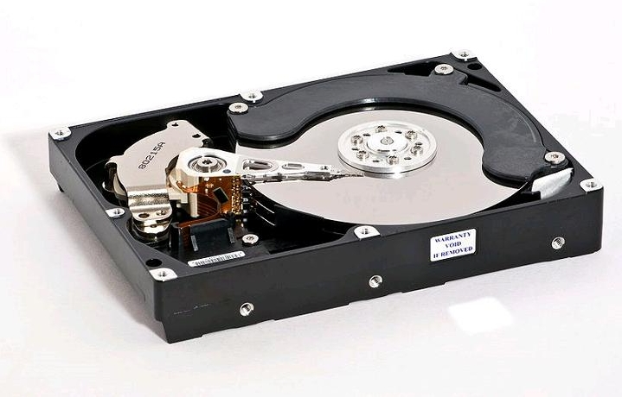
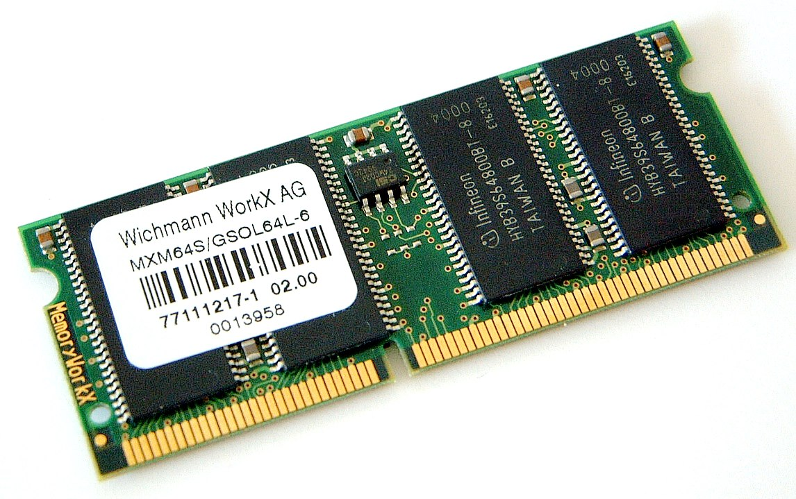
Permacoin - Mining with storage
Permacoin
Miller et al., 2014
Bitcoin
Side effect:
Massively distributed, replicated storage system
Notes:
hard disk image from wikipedia

Slide 25
Permacoin
Assume we have a large file F to store
For simplicity: F is chosen globally, at the beginning, by a trusted dealer
Each user stores a random subset of the file

Slide 26
Storage-based puzzle
1. Build a Merkle tree, where each leaf is a segment of the file
2. Generate a public signing key pk, which determines a random subset of file segments
F₁
F₂
F₄
F₅
3. Each mining attempt:
F₂
F₄
a) Select a random nonce
b) h1 := H(prev || mrkl_root || PK || nonce)
c) h1 selects k segments from subset
d) h2 :=
H(prev || mrkl_root || PK || nonce || F)
e) Winner if h2 < TARGET
F₀
F₁
F₁
F₂
F₂
F₂
F₃
F₄
F₄
F₄
F₅
F₅
F₆
F₇
Notes:
too much text here

Slide 27
Summary
Useful proof-of-work is a natural goal
(while maintaining security requirements)
The benefit must be a pure public good
Viable approaches include storage, prime-finding, others may be possible
Realized benefit so far has been limited

Slide 28
Nonoutsourceable Puzzles

Slide 29
Large mining pools are a threat
Bitcoin’s core value is decentralization
If power is consolidated in a few large pools, the operators are targets for coercion/hacking
Position: large pools should be discouraged!
Analogy to voting: It’s illegal (in US) to sell your vote

Slide 30

Standard Bitcoin mining pool
Payout dividing among members
Pool Operator
“shares”:
proof that a member is
“toeing the line”
Pool Members
Solution found!

Slide 31
The Vigilante Attack
Suppose a Vigilante is angry with a large pool
He submits “shares” like normal….
… but if he finds a real solution, discards it
Pool output is reduced, Vigilante loses a little

Slide 32



The Vigilante Attack
Payout dividing among members
Pool Operator
Solution
discarded
“shares”:
proof that a member is
“toeing the line”
Pool Members
Notes:
guy fawkes, trashcan, and key icons from openclipart

Slide 33
Encouraging the Vigilante
Whoever FINDS a solution spends the reward
Approach:
- searching for a solution requires SIGNING, not just hashing. (Knowledge of a private key)
- Private key can be used to spend the reward

Slide 34
Encouraging the Vigilante
Pool Operator
“shares”
Pool Members
Solution found!
Take the money and run!
Also: evade detection
Notes:
Key from openclipart

Slide 35
Nonoutsourceable puzzle
Signature needed to find solution
Solution:
(prev, mrkl_root, nonce, PK, s1, s2)
such that:
H(prev || PK || nonce || s1) < TARGET
VerifySig(PK, s1, prev || nonce)
VerifySig(PK, s2, prev || mrkl_root)
Public Key
Second signature spends reward
Notes:
Need to compute S1 to find out valid puzzle solution
Only when you find out the valid hash you used second S2 to choose which transactions needs to be included

Slide 36
Nonoutsourceable puzzle concerns
This puzzle discourages ALL pools
including harmless decentralized P2Pools
Other forms of outsourcing
might drive pool members to hosted mining

Slide 37
Proof-of-Stake
“Virtual Mining”

Slide 38


Mining has an unnecessary step
Proof-of-Work Mining:
Earn mining rewards
Spend money on power and equipment
Miner
Find puzzle solutions
Notes:
Factory image from wikipedia
Miner image from Lecture 4

Slide 39
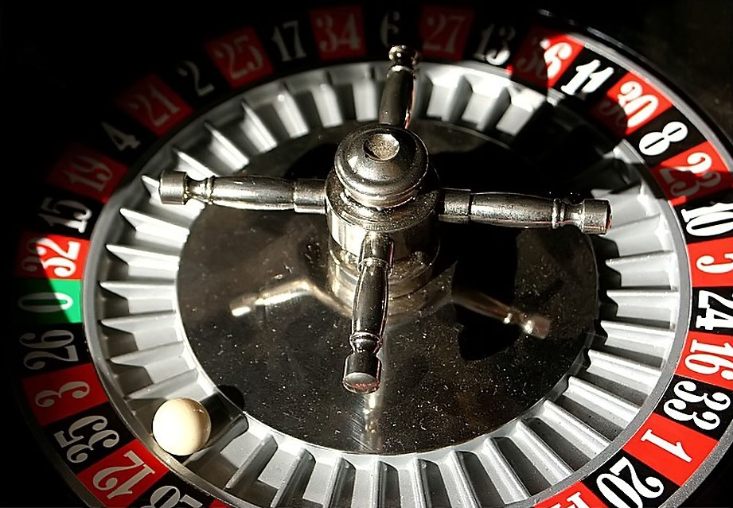
Mining has an unnecessary step
Virtual Mining:
Earn mining rewards
Miner
Winners chosen at random by lottery
“Mine” by sending money to a special address

Slide 40
Potential benefits
Lower overall costs
- No harm to the environment
- Savings distributed to all coin holders
Stakeholder incentives - good stewards?
No ASIC advantage
51% attack is even harder

Slide 41


51% attack prevention
The Bitcoin economy is smaller than the world
Wealth outside Bitcoin has to move inside
Bitcoin Economy
Wealthy Attacker
Bitcoin Economy
Wealthy Attacker
Exchange
Attack
Attack
Notes:
Money and Capitol icons public domain from pixabay

Slide 42
Variations of Virtual Mining
Proof-of-Stake: “Stake” of a coin grows over time
as long as the coin is unused
Proof-of-Burn: mining with a coin destroys it
Proof-of-Deposit: can reclaim a coin after some time
Proof-of-Activity: any coin might be win (if online)

Slide 43
Open Questions with Virtual Mining
Is there any security that can only be gained by consuming “real” resources?
If so, then “waste” is the cost of security
If not, then PoW mining may go extinct

Slide 44
Conclusion
Many possible design goals
Prevent ASIC miners from dominating
Prevent large pools from dominating
Intrinsic usefulness
Eliminate the need for mining hardware at all
Best tradeoff is unclear for now
Outlook: alternatives will coexist for the near future

